Slide 1

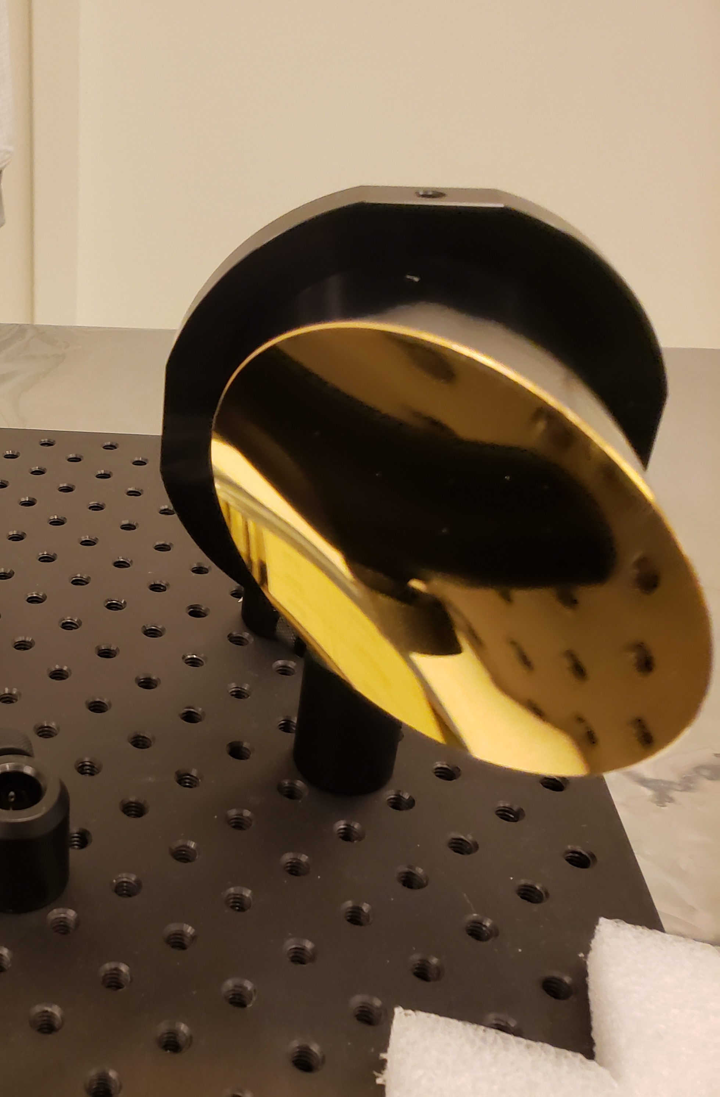
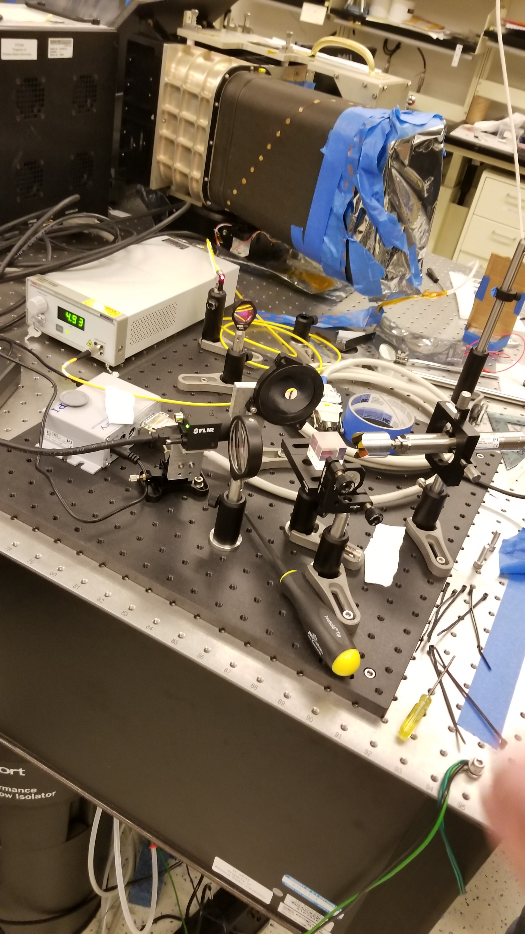
Handheld IR Spectrometer
(HIRS) Instrument
NASA Space Grant Undergraduate Research Symposium Presentation
By: Ryan Fagan
Notes:
Into, short and sweet

Slide 2
Presentation Scope
Mission Statement and Requirements
Background Information: Michelson Interferometers and Spectroscopy
HIRS Design – Optics
HIRS Design – Structure
HIRS Design – Performance
Notional Data Product
Summary and Next Steps
Notes:
Just read it

Slide 3
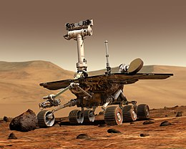
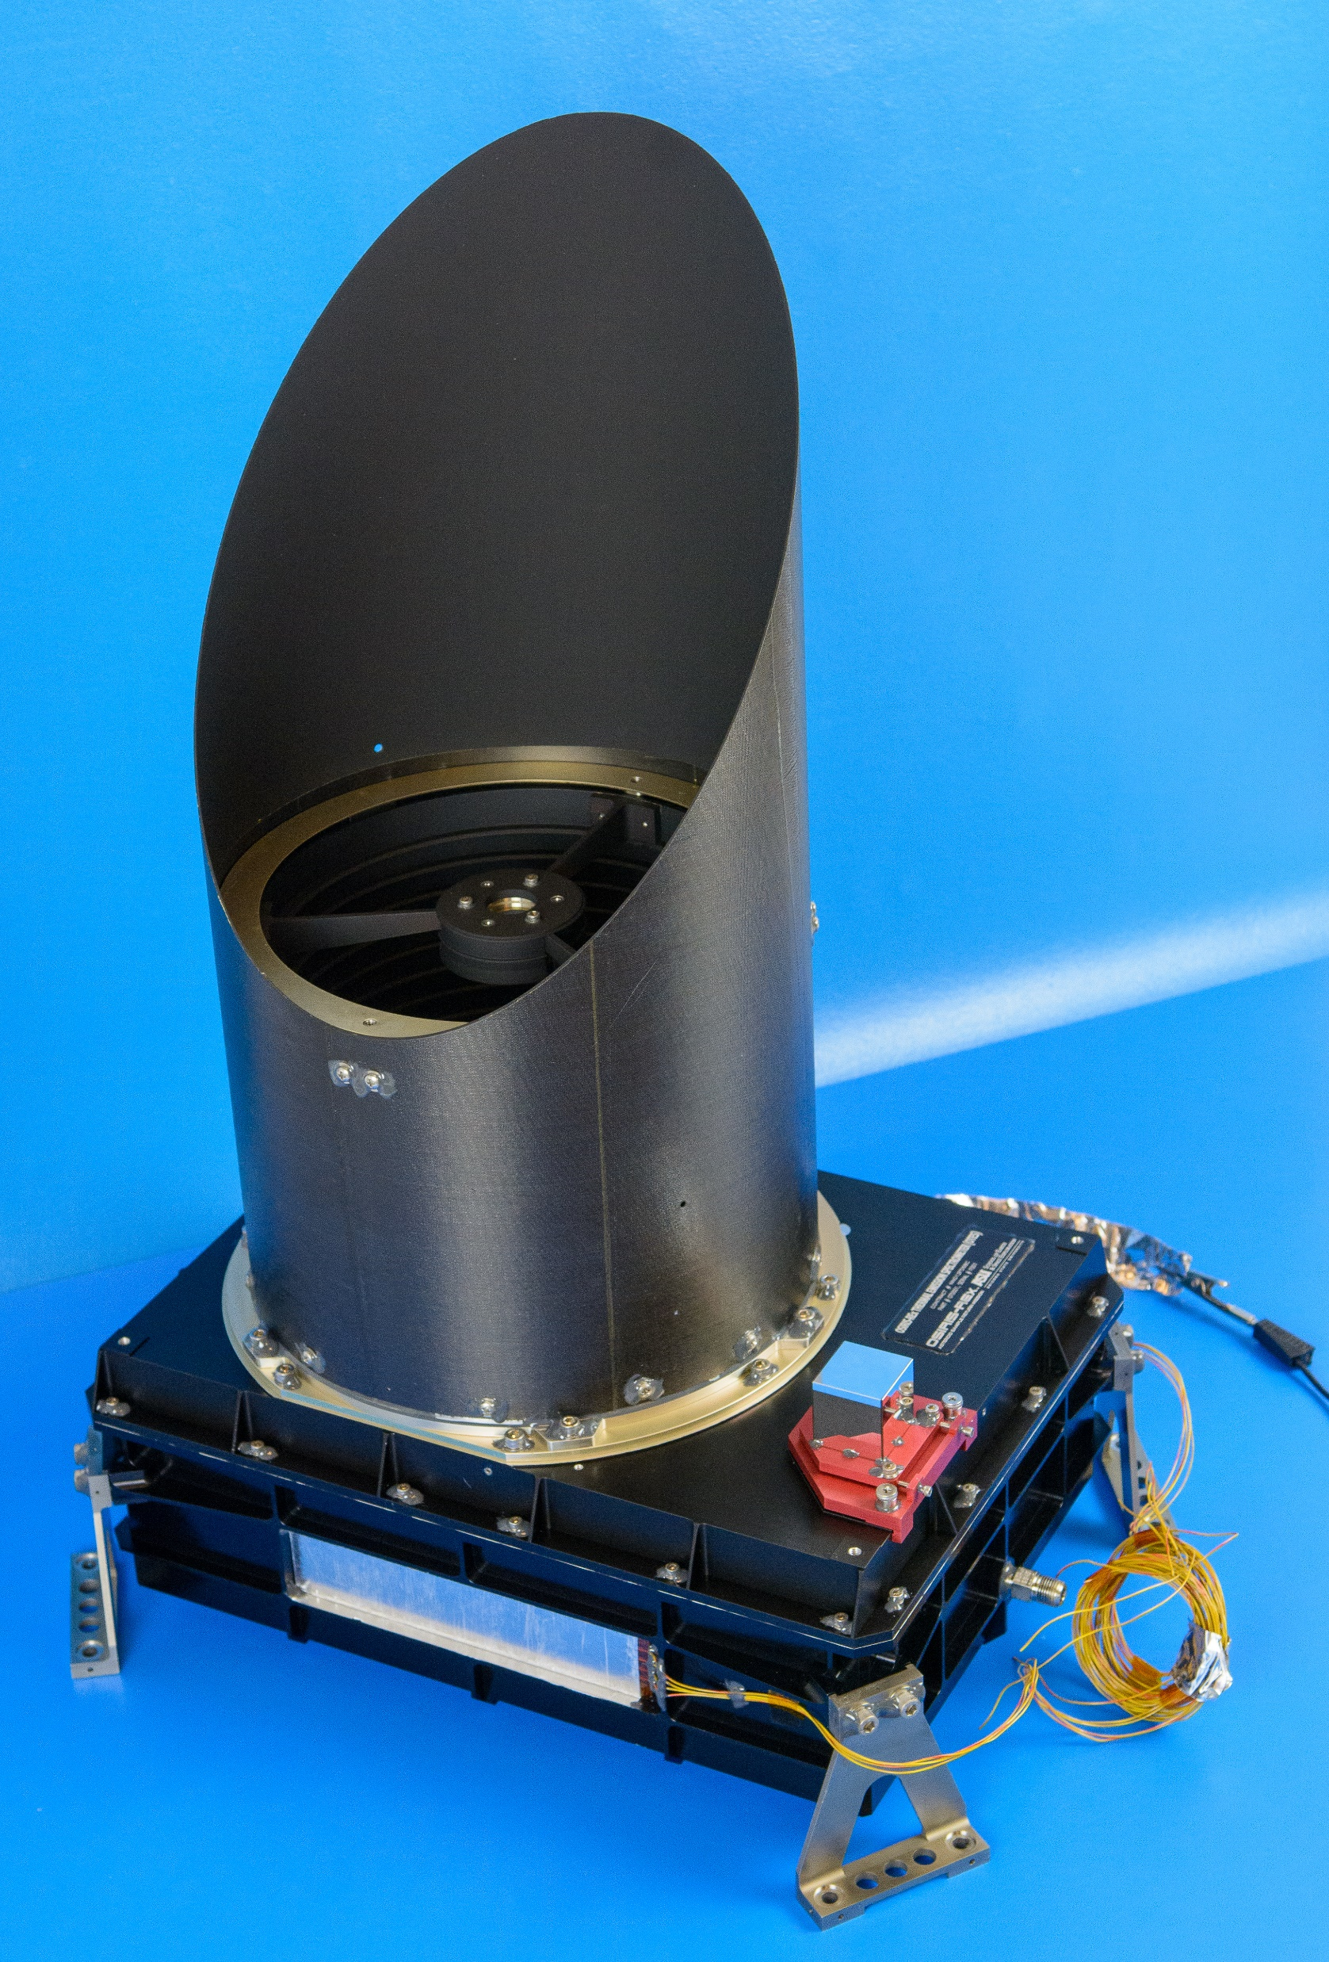
Mission Statement and Requirements
Goal: Design a competitive, field deployable method of identifying geological samples.
Method: Modify the OTES and Mini-TES family of instruments for use as a portable instrument.
Requirements:
  Cost below $50K to align with similar, but less capable instruments on the market.
  Broad spectral range covering at least 10um-30um.
  Signal to Noise Ratio above 100 to identify 1% spectral features.
  Spectral resolution of 5cm⁻¹ to be compatible with current spectral database.
https://www.jpl.nasa.gov/missions/mars-exploration-rover-spirit-mer-spirit/
http://otes.asu.edu/
Notes:
Most of it has changed, only det, bs remain

Slide 4
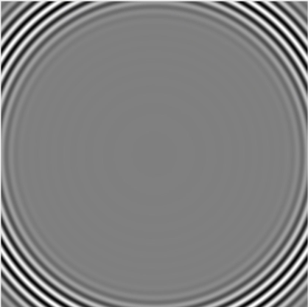
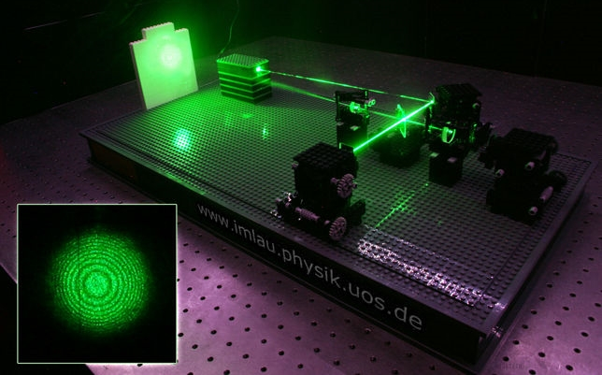
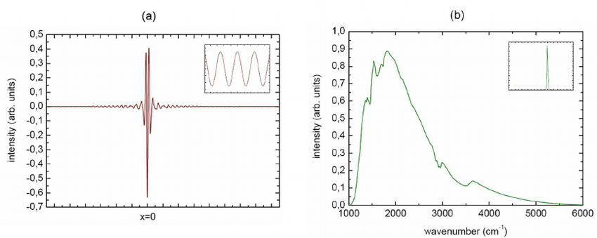
Essential Concepts of Interferometers
https://www.jimlau.physic.uos.de
Notes:
Explain how it works, and show figure creates plot

Slide 5
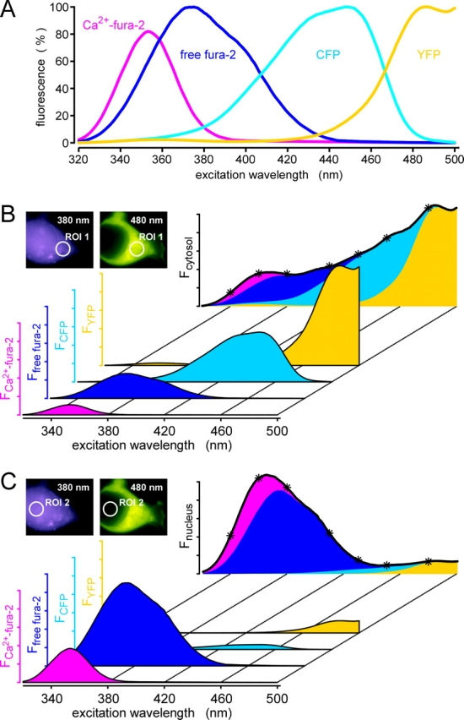
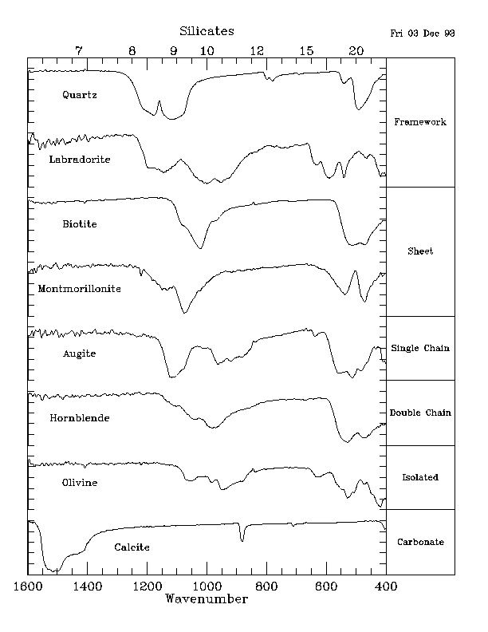
Essential Concepts of Emission Spectroscopy
http://sprout038.sprout.yale.edu/imagefinder/ImageDownloadService.svc?articleid=2173038&file=200203048f1&size=LARGE
https://www.researchgate.net/figure/a-shows-the-interferogram-and-b-the-corresponding-spectrum-of-a-globar-light-source_fig6_264885356
http://tes.asu.edu/TESNEWS/4_VOL/No_2/pyroxene_veh.htmlphysics-and-radio-electronics.com/physics/waveinterference.html
Notes:
Start with blackbody radiation

Slide 6
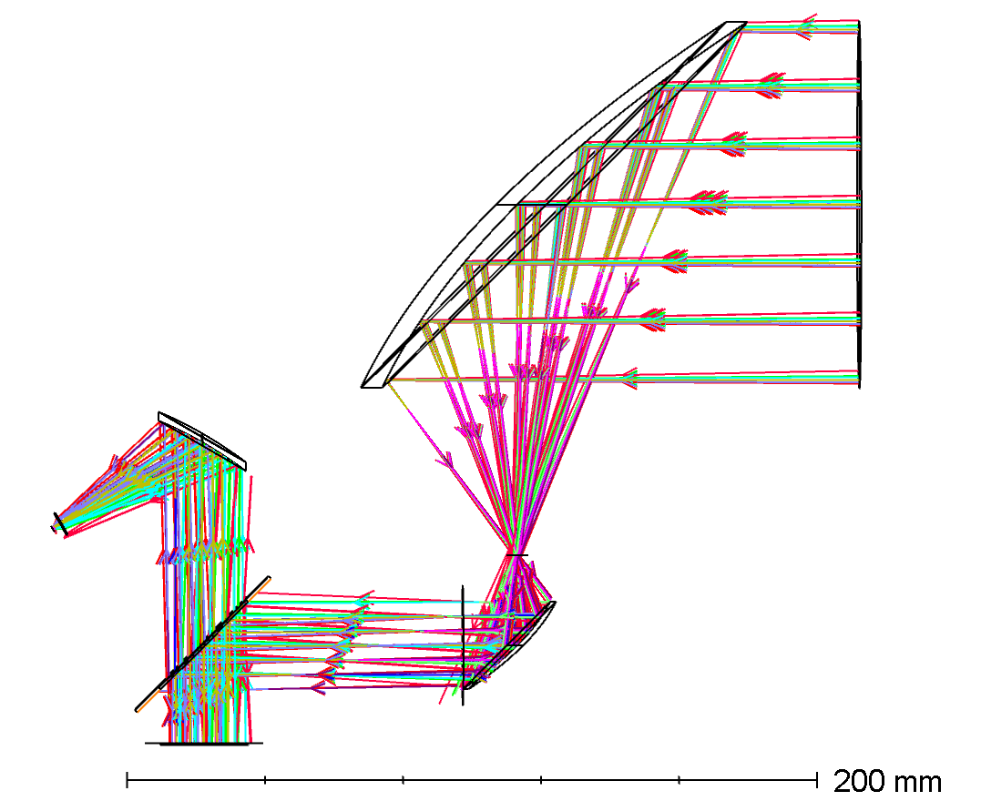
HIRS –
Basic Layout
Telescope Section
Contains primary and secondary mirror.
Defines FOV and collection area.
Interferometer Section
Contains moving mirror, beamsplitter, and fixed mirror.
Source of tightest tolerances and source of motion sensitivity.
Detector Section
Contains focusing mirror field stop and detector element.
Detector Section
Telescope Section
Interferometer Section
Notes:
Overview, ignore bullets - talk about the section and tis general purpose, 1 sent

Slide 7
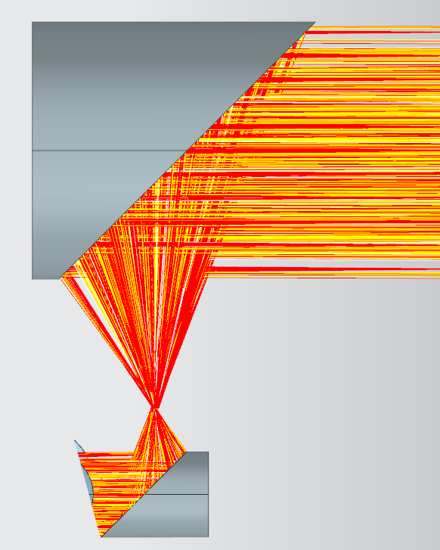
Telescope Section
General
  F/1 (ratio of focal length to diameter)
  A-focal ratio of 3
  FOV 20mrad (1.15 deg)
  Gold plated
Primary Mirror – ED# 83-195
  3 inch diameter, 90° OAP
Secondary Mirror – ED# 47-086
  1 inch diameter, 90 ° OAP
FWHM: 20mrad
Notes:
Talk about job, how it accomplished it

Slide 8
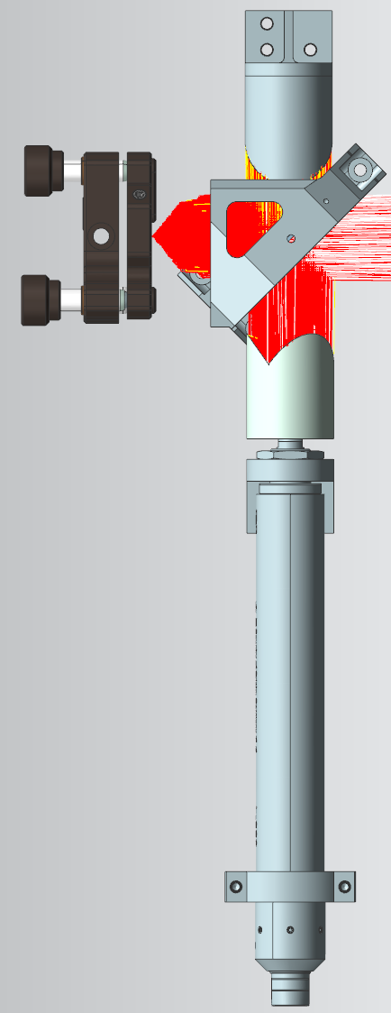
Interferometer Section
Motor – PI# L-220 DG
  Nano-positioning Stepper motor (20nm)
  125 N Push Force
Moving Mirror – NP# 50326-1002
  Corner Retroreflector (tilt insensitive)
Fixed Mirror – TL# PF10-03-M03
  1 inch Flat Mirror
Beamsplitter
  Germanium Coated Diamond (2um-100um+)
Notes:
Talk about each of the components and what they do

Slide 9
L-220 Dg Motor Performance
Small movement error < 50nm
Stepping Frequency > 5600Hz
Angular Error > 1mrad (0.06 deg)
Notes:
Talk about motor performance, and why tilt requires corner cube

Slide 10
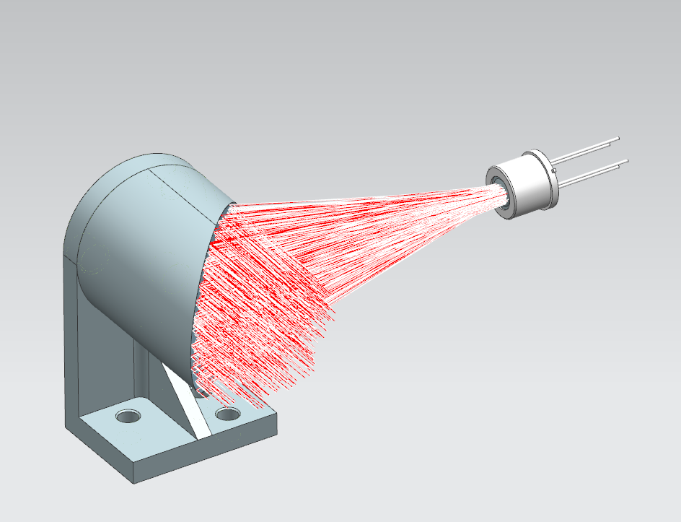
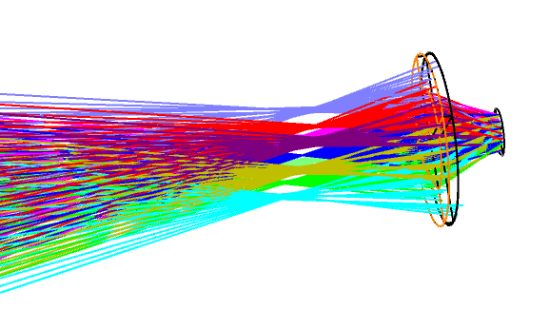
Detector section
Focusing Mirror - ED# 35-644
  F/2
  1 inch diameter, 90° OAP
Detector Lens
  Spherical Diamond
Detector Element – DLaTGS Pyroelectric Detector
  Frequency dependent response
  Generates a charge based on applied thermal gradient

Slide 11
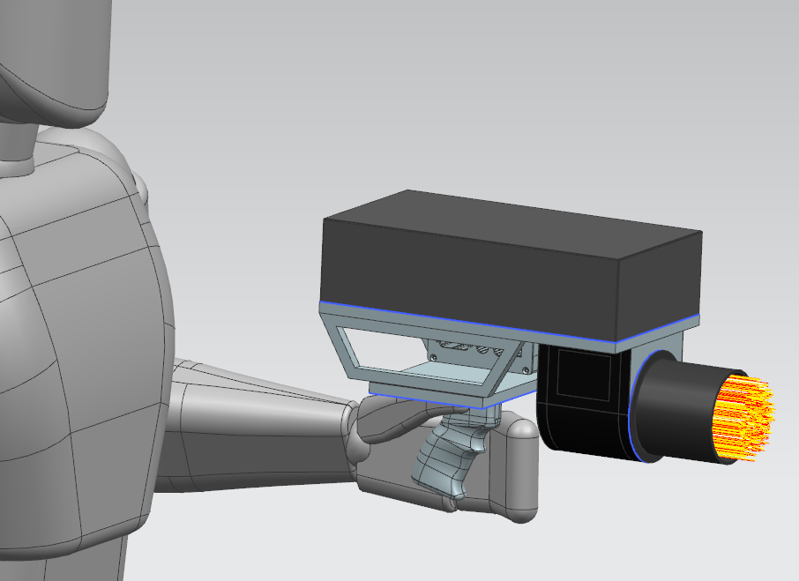
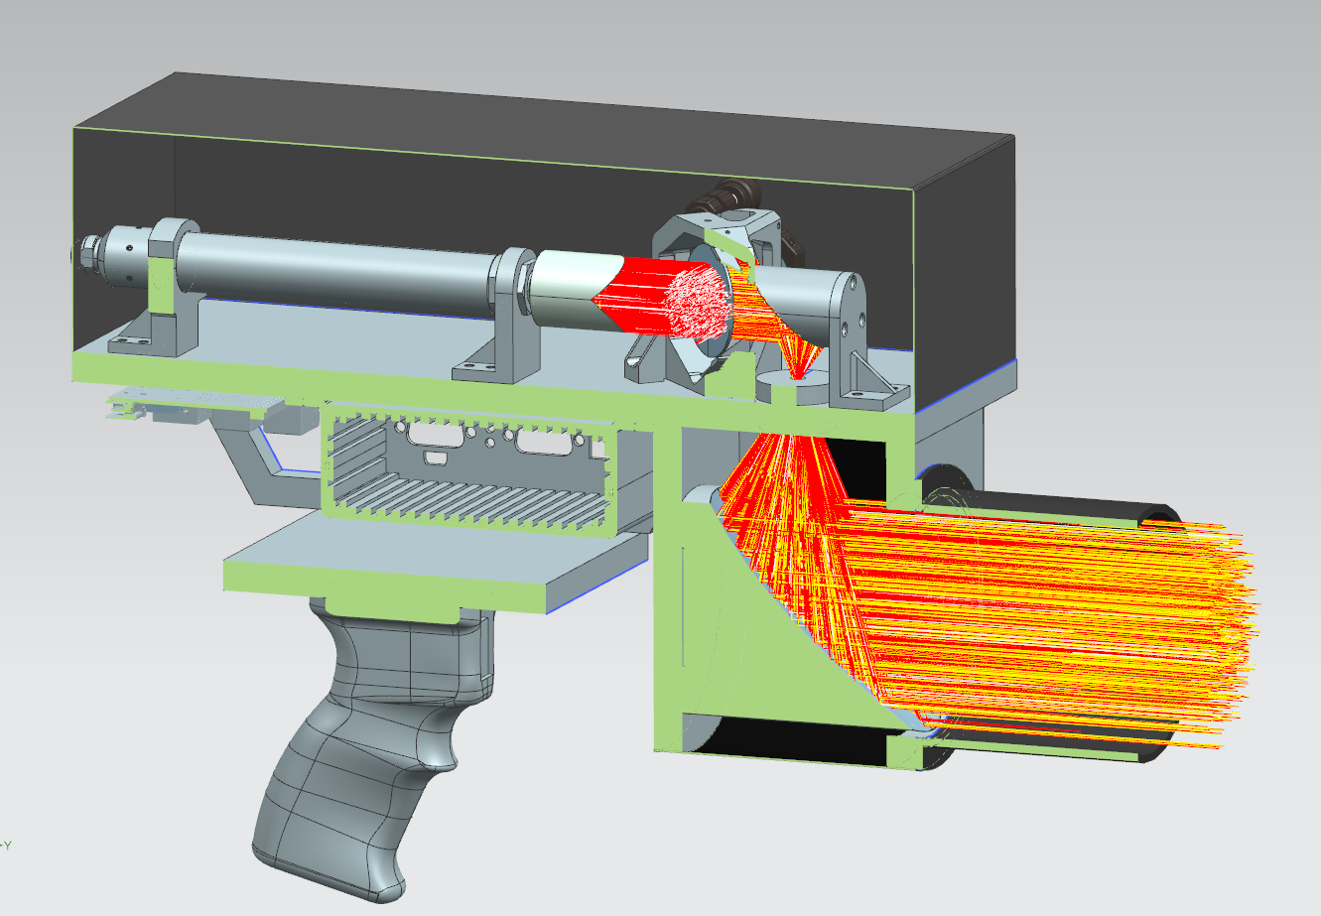
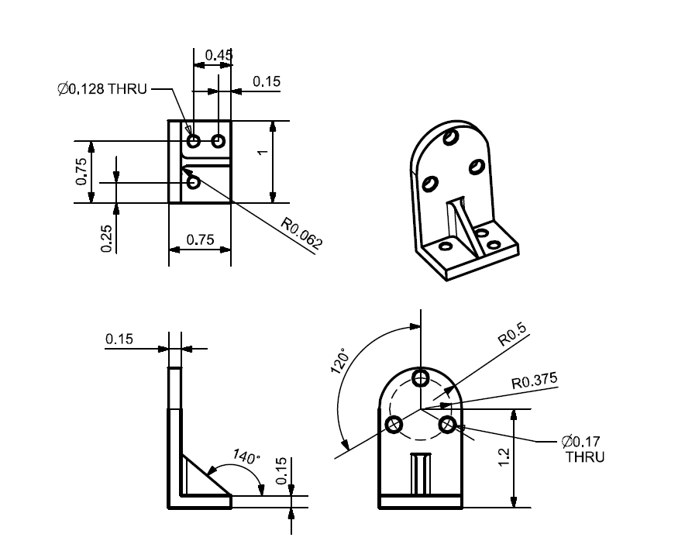
Supporting Structure- Key Considerations
High Tolerances on optical components
  50 um positioning in interferometer
  0.004 deg rotation in interferometer
  0.5 mm positing in telescope
  0.5 deg rotation in telescope
Viable for manual machining - simple geometry
  Moving to CNC would reduce weight and decrease form factor significantly.
Notes:
Simple but adhears to principals of a single plate for all elements to sit on, make alignment easier

Slide 12
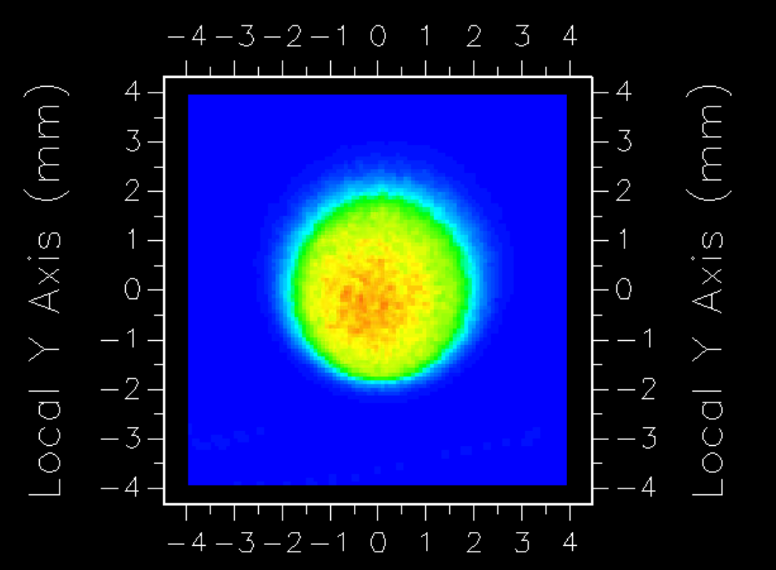
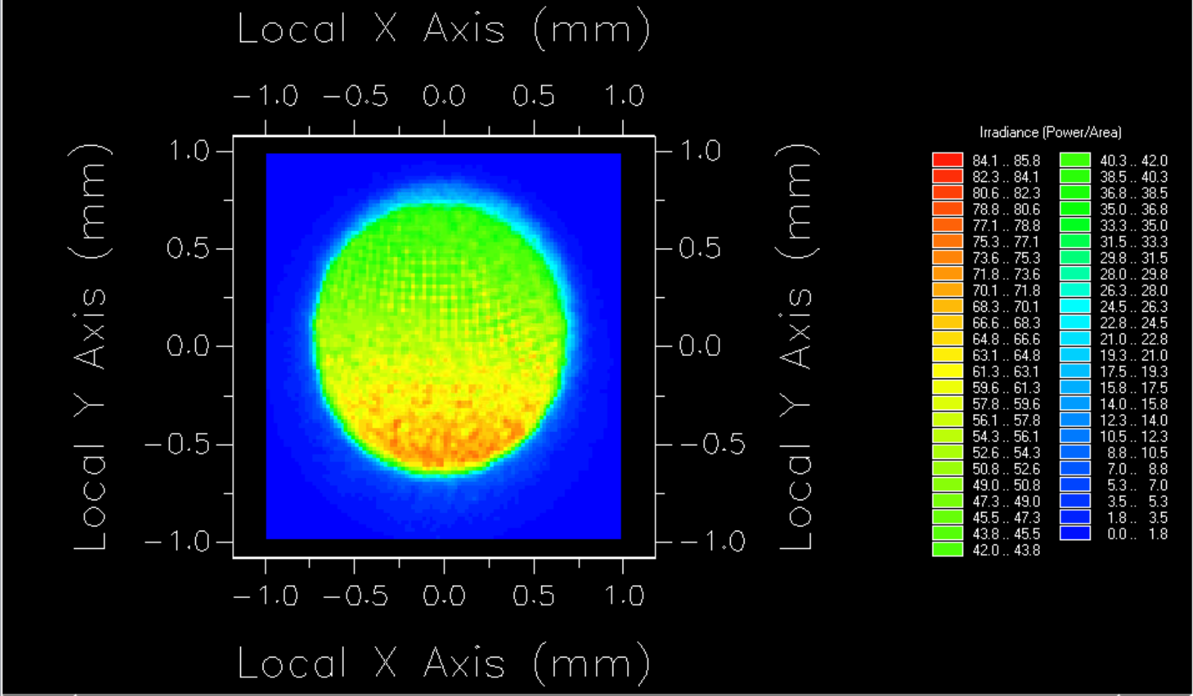
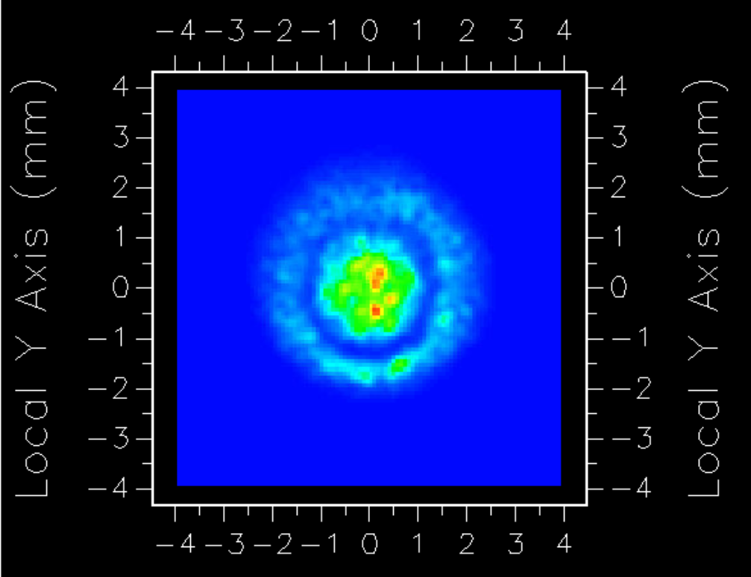
Energy Distribution
Energy On Lens Surface
Energy on Detector
Interference Fringe- 5um
Good uniformity across field, slight aberrations caused by OAP’s are visible.
Aberrations caused by OAP create significant distortions on detector element.
Fringe pattern shows modulation efficiency at a given wavelength, large effect on resulting signal level.
Notes:
Aberrations show system is currently at its limit for COTS parts
Fringe shows good alignment for interferometry

Slide 13

Performance
$$NESR=\frac{\sqrt{2∗A_{det}∗Δf}}{D^{star}}∗\frac{1}{AΩ_{0}∗τ_{total}∗K_{fv}∗δv∗√N_{samples}}$$
NESR = (Detector Contributions) * (Optical System Contributions)
SNR > 100 for 7um – 40um
SNR > 250 for 10um – 30um
Expected
Requirement
Notes:
Fundamental
Applied to a regular earth sample

Slide 14
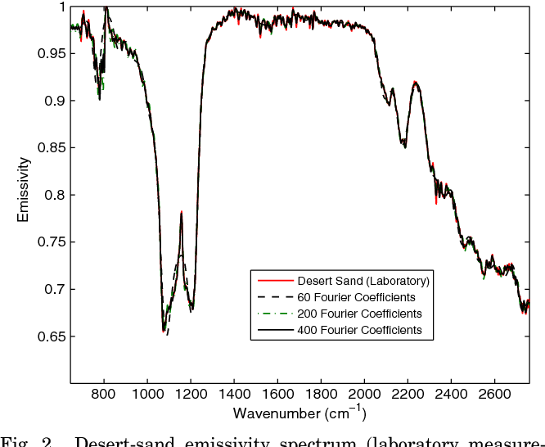
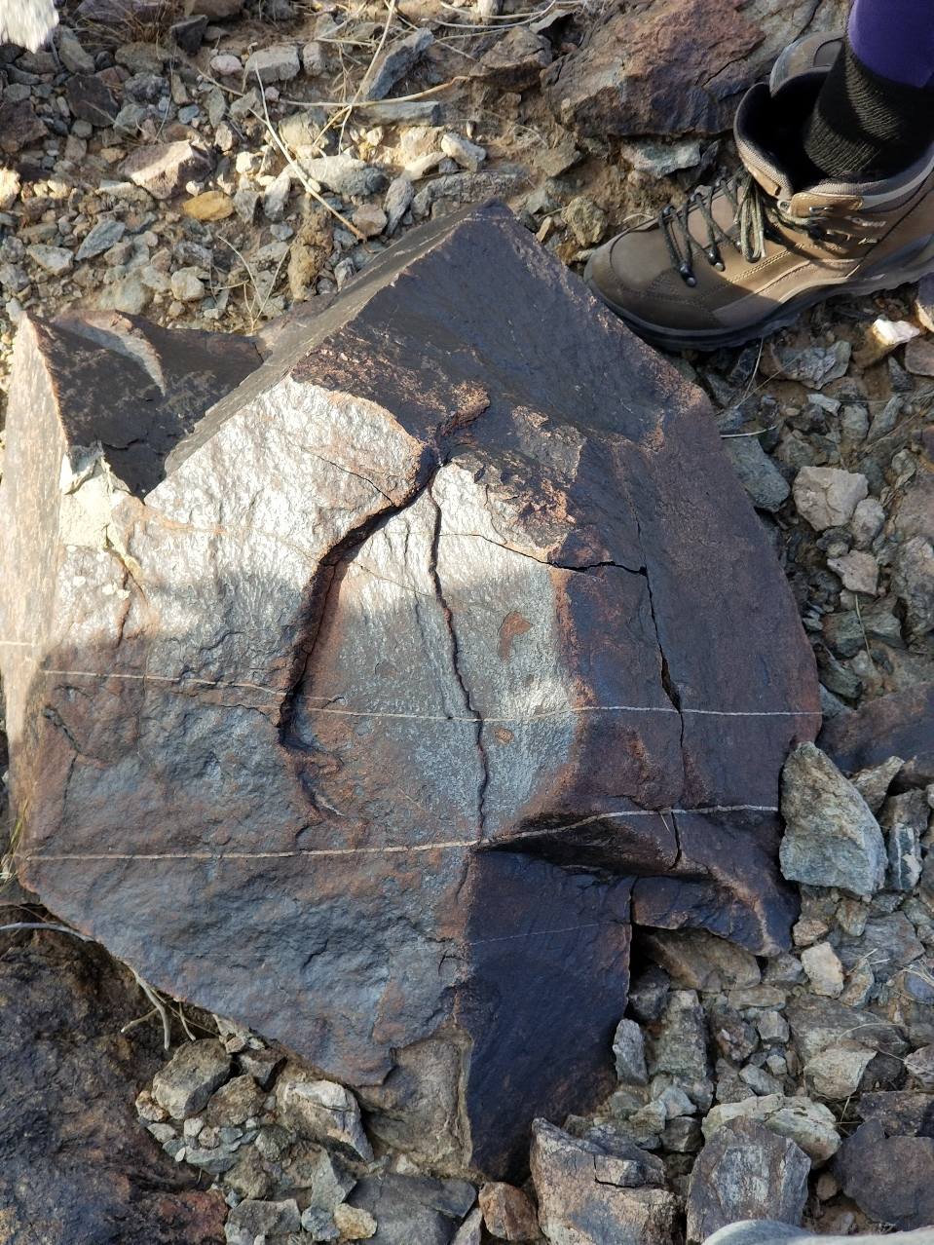
Notional Data Product
Constituent Material | Concentration
Appetite – Bulk crystal | 0.756
Iron Oxide – 50um Grain | 0.124
Quartz – Bulk crystal | 0.030
Anhydrate – Bulk crystal | 0.025
Other | 0.065
Total Identified Materials | 0.935
https://www.semanticscholar.org/paper/Simultaneous-physical-retrieval-of-surface-spectrum-Masiello-Serio/2326771939e953dc5abe4339d123f9ed8e0d4023

Slide 15
Summary and next steps – Masters Program
Designed a compact, high power optical system with excellent system performance.
Designed a vibration and movement insensitive moving mirror system.
End to end analysis of full system performance and capabilities.
Complete benchtop model test. (June)
Upgrade Structure for CNC manufacturing. (June)
Build tethered prototype (August)
Design integrated electronics and software. (TBD)
Build full prototype (TBD)

Slide 16
Questions?

